Slide 1
FAIR Project
By Jennifer van Langen & Lucca Ferri de Souza

Slide 2
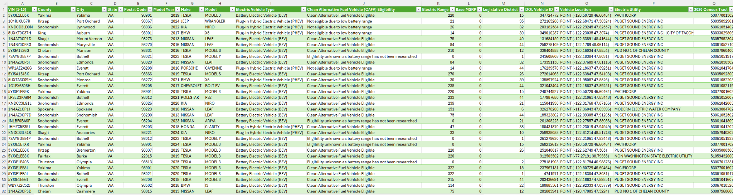
Introduction
State of Washington's Electric Vehicle Population Data
  USA government data
17 columns, each row is a Vehicle
Limited metadata
  Landing page has more information
I think we should also describe the data preparations, since then we can easily explain what the current format + data is

Slide 3
FAIRification planning
Goals:
  Add rich metadata and URIs
  Map data to existing ontologies
  Make dataset more readable
Stakeholders
  Government agencies
  Researchers
Existing FAIR-support:
  Identifiers
  License

Slide 4
Data Preparation
Removed: Base MSRP, Legislative District, Vehicle Location and Electric Utility
Merged: City, County and State into City due to Findability
Reconciled: City, Make, Model and Electric Vehicle Type
Unique global identifier
The reconciliation used onthologies from wikidata.org

Slide 5
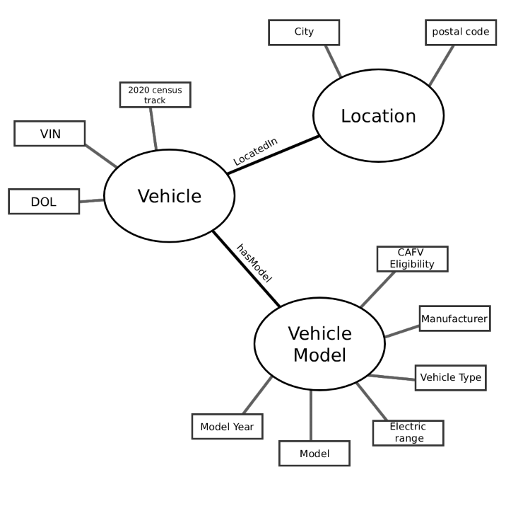
Semantic data model
Three entities
Relationships
Attributes

Slide 6
Metadata schema
Findable and reusable:
Title
Description
Creator
License
Language
Keywords
Notes for me:
Metadata of the SHACL
Multiple properties, each has a description, min and max quantity of the entity, a description, the datatype,
Findable and reusable:
Title
Description
Creator
Issued
License

Slide 7
FAIRness improvements
Findability:
  Proper identifiers
  URIs making data linkable
  Adding rich metadata
Accessibility:
  Using a standardised protocol for RDF
Interoperability:
  Reconciliation
  Using standardised vocabularies
Reusability:
  Describing the (meta)data extensively

